Slide 1
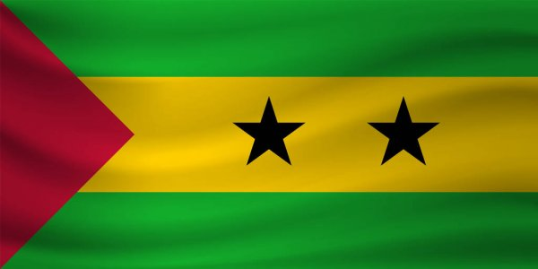
São Tomé e Príncipe

Slide 2
January 4th | Day of King Amador
February 3rd | Batepá Massacre
July 12th | Independence Day
September 6th | Armed Forces Day
September 30th | Nationalisation of the ‘Roças’
December 21st | São Tomé Day

Slide 3
Nobody lived on the islands before the arrival of the Portuguese colonists, at the end of the 15th century. Portuguese ships loaded with slaves stopped there on their way to Brazil. On the islands, slaves grew sugar cane and cocoa for Portugal. São Tomé and Príncipe became independent from Portugal in 1975. The country had free elections for the first time in 1991.

Slide 4
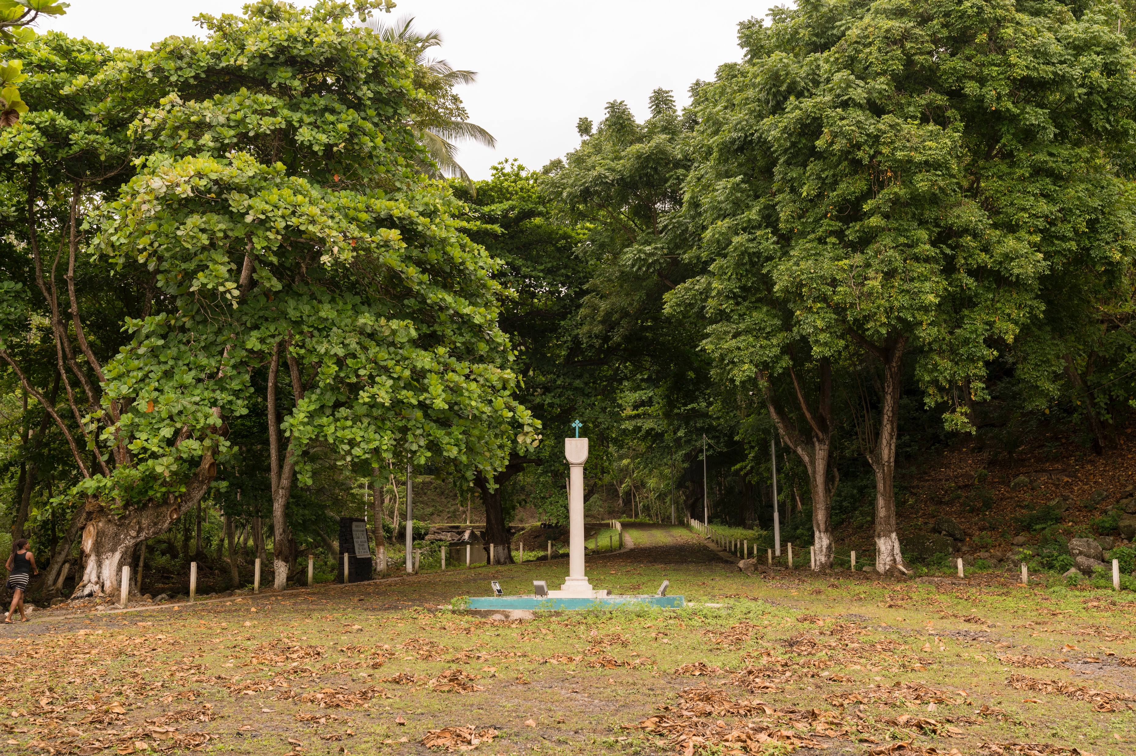
Portuguese discovery pattern

Slide 5
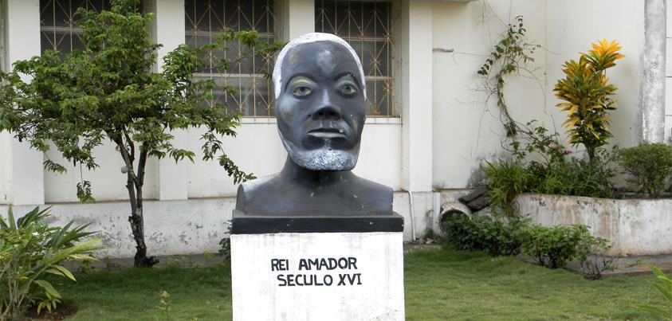
January 4th | Day of King Amador
Statue of Rei Amador: one of the illustrious people who fought for the independence of our country.

Slide 6
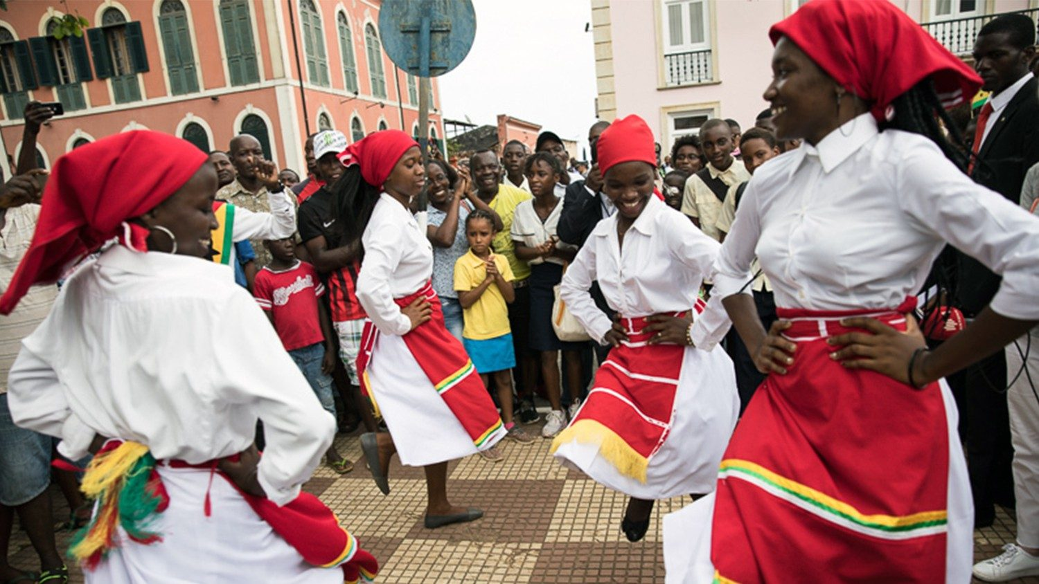
July 12th | Independence Day
Independence day celebration.

Slide 7
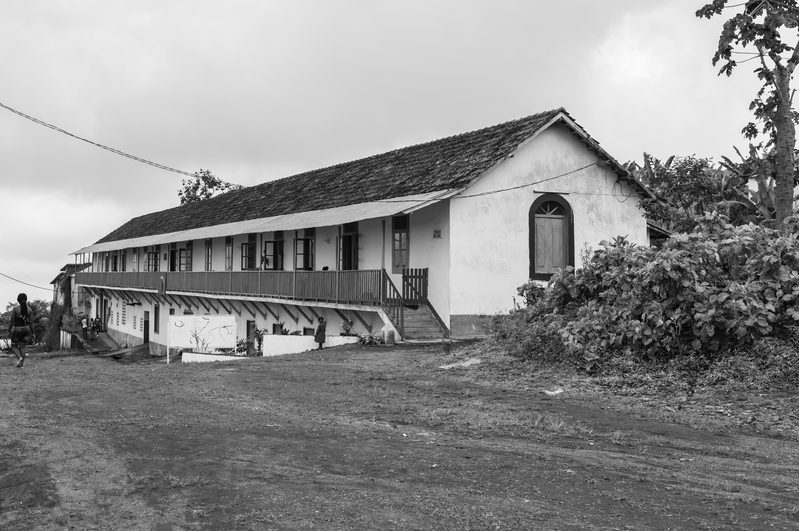
September 30th | Nationalisation of the ‘Roças’

Slide 8
Coat of arms of São Tomé and Príncipe. ‘’Democratic Republic of São Tomé and Príncipe’’. ‘’Unity, Discipline and Work ''.

